Slide 1
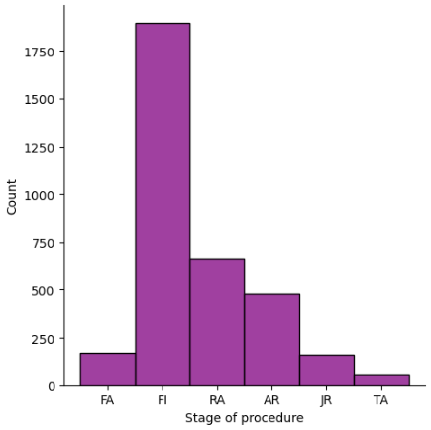
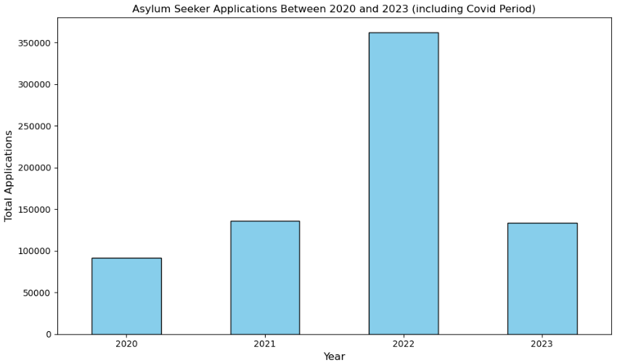
An examination of the “The movement of people” using the UN Data sources
Rodney Wardle SBS23057
Capstone Project Final Poster For Strategic Thinking
Introduction
Technologies Used
Model Evaluation Key Metrics
Challenges Encountered
This capstone project was to look at UN data for asylum seekers application . It was supplied from the official UN data website. This data is based off global figures for asylum seeker applications and to create machine learning models to predict future applications.
This capstone project followed the CRISP DM Methodology
Business Understanding → Data Understanding → Data Preparation → Modelling → Evaluation → Deployment
Libraries Used: pandas,seaborn, numpy,sklearn,matplotlib etc.
For hyperparameter tuning Grid Search CV was used.
Machine Learning Algorithm used: Decision Tree, K Nearest Neighbor and K Means
Label Encoder was used to deal with the categorical data
Precision: this focuses on the proportion of the true positive predictions amongst all predictions
Recall: This focuses on the proportion of true positives among all the actual positive ,
F1 Score: This combined the precision and recall into a single metric.
A full deep clean of the data was needed to be done. Converting from categorical to numerical This took the longest.
It was extremely hard to interpreted the results from the models. The hardest model was the Decision Tree Classifier.
There is a vert strong need to set the best possible research
Visualizations
5 Main Objectives
1.How can data science be used to analyze the growing number of asylum seekers around the world.
2.Examination of available data may help to predict the future applications for asylum seekers across the world
3.To develop a machine learning model to estimate the number of asylum applications. Following the CRISP-DM Project management framework for data analysis.
4.Compare the estimates of applications both supervised and unsupervised and a description of exactly what this entails.
5.To take a deeper look into the global figures to allow for some examination of the movement of peoples within Europe, America, Asia and Oceania (Australia).
Model Evaluation
Conclusion
References
Model | Precision | Recall | F1 Score
Decision Tree | 0.24 | 0.93 | 0.39
KNN | 0.21 | 0.87 | 0.46
We have been able to show successfully that a machine learning algorithm can be used in the prediction of the amount of asylum seekers applications and to prepare for the future needs for the asylum seekers globally as a whole.
More work is required to get the accuracy up higher into 90% +.
More finetuning is needed to get the best results possible.
unstats.un.org. (n.d.). UNSD — Demographic and Social Statistics. [online] Available at: https://unstats.un.org/unsd/demographic-social/sconcerns/migration/.
Smart Vision Europe (2017). Building and Applying Predictive Models in IBM SPSS Modeler training webinar. [online] Smart Vision - Europe. Available at: https://www.sv-europe.com/crisp-dm-methodology/.
IBM (2023). What is a Decision Tree | IBM. [online] www.ibm.com. Available at: https://www.ibm.com/topics/decision-trees.
Team, G.L. (2023). Label Encoding in Python - 2023. [online] Great Learning Blog: Free Resources what Matters to shape your Career! Available at: https://www.mygreatlearning.com/blog/label-encoding-in-python/#:~:text=Label%20encoding%20is%20a%20technique.
Kaushik, S. (2019). An Introduction to Clustering & different methods of clustering. [online] Analytics Vidhya. Available at: https://www.analyticsvidhya.com/blog/2016/11/an-introduction-to-clustering-and-different-methods-of-clustering/.
K Means clustering best model results:
Best hyperparameters found by GridSearchCV: {'init': 'random', 'max_iter': 100, 'n_clusters': 8, 'n_init': 10}

